Slide 1
Specialised Animal Cells I

Slide 2
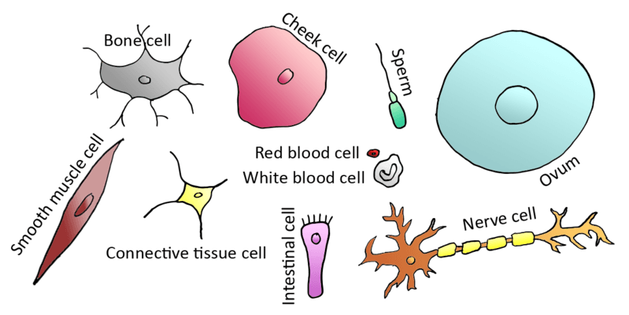
In this Smart Lesson, you will be doing the following:
1. | Naming types of specialised animal cells.
2. | Explaining what specialised cells are.
3. | Describing the structure of muscle cells and nerve cells and relating the structure of each type of cell to its function.

Slide 3

When you first think about running, your brain sends messages to your leg and arm muscles through specialised nerve cells.
The muscles in your legs and arms are made up of specialised muscle cells.
Your muscles pull on your bones, which are made up of specialised bone cells.
All of these different types of cells have special functions, and they all work together to help your body to move.

Slide 4
You are a multicellular organism, which means you are made up of many different types of cells that carry out special functions.
In unicellular organisms, like bacteria, the whole organism is made of just one cell. This cell must carry out all the functions of life!

Slide 5
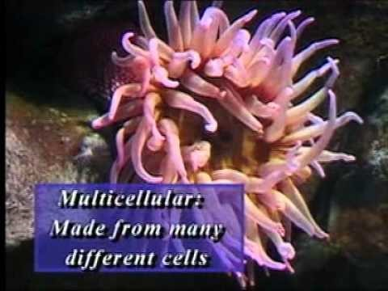

Slide 6
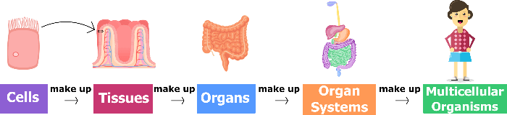
An advantage of being a multicellular organism is that you can be larger and more complex than unicellular organisms.
The different functions (such as movement, digestion, removal of waste, etc.) can be performed by different types of cells, which makes it more efficient. Imagine if every one of your cells was trying to do all of the jobs needed to keep your body functioning! That would be chaos.

Slide 7


The structure of a cell refers to what the cell looks like.
Things such as shape, size and the types of organelles it contains are a part of a cell's structure.
The function of a cell refers to what the cell does.
In biology, the way an object or organism is shaped (its structure) is always closely related to its function.

Slide 8
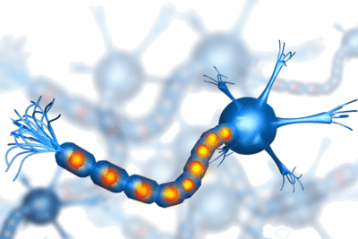
When a cell is specialised, it means that it has a special job (function) to do.
The structure of a cell is also specialised to help it do that specific job.
For example, nerve cells transmit messages between different parts of the brain and body. This is their function. They can be very long, with some nerve cells reaching from the base of your spine to the tip of your big toe - over a metre! This is their structure.

Slide 9
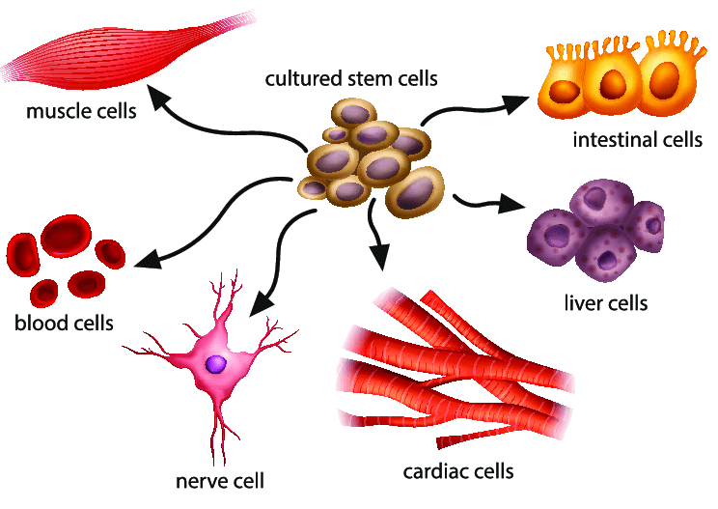
You have over 200 different types of cells in your body!
Each of these different cell types has a specific function. The cells all work together but they don't all do the same thing.
This means that if the function of one type of cell is disrupted it can affect the functioning of the whole body.

Slide 10
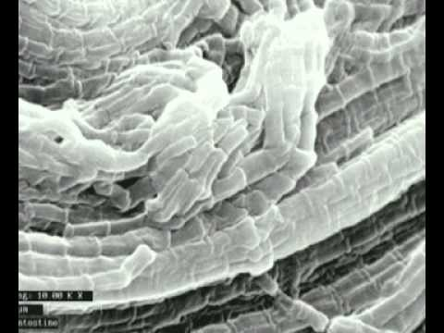

Slide 11
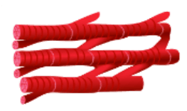
Muscle cells are long, thin cells that can contract and relax.
They have lots of mitochondria in them to provide energy to do this. They can change size a lot, so you can probably guess their function: they allow parts of your body to move.

Slide 12
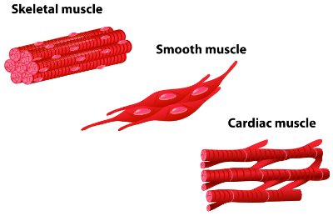
There are actually three different types of muscle in your body: skeletal muscle, smooth muscle and cardiac muscle.
They are all made up of cells with many mitochondria to produce the energy required to continue contracting.

Slide 13

Skeletal muscles are the muscles that are attached to your skeleton to help you move your body around.
These muscles are called voluntary muscles, because you can control whether or not they move. For example, you must make a conscious decision to move your arm towards your mouth when you want to eat food.

Slide 14
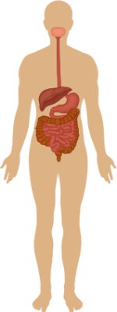
Smooth muscles are the muscles found in your organs.
They do things like move food through your gut and help you to breathe. These muscles are called involuntary muscles, because they move without you having to think about it.
For example, the muscles in the wall of your digestive tract contract to move food along from your stomach through your intestines. You don't have to think about this to make it happen.

Slide 15
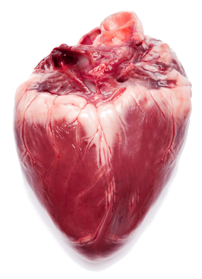
Cardiac muscles are the muscles found in your heart.
Cardiac means related to the heart. Cardiac muscles are involuntary muscles, because they move without you having to think about it.
The muscles in your heart must continue to contract and relax in a specific rhythm without stopping, so that blood is pumped around your body to keep you alive. No wonder they are special!

Slide 16
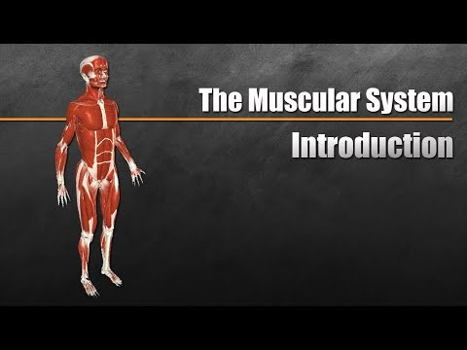

Slide 17
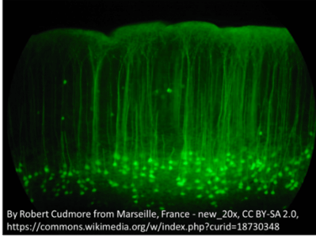
Your nervous system is made up of nerve cells (neurons).
This includes your brain as well as the nerves that carry information between your brain and other parts of your body.

Slide 18
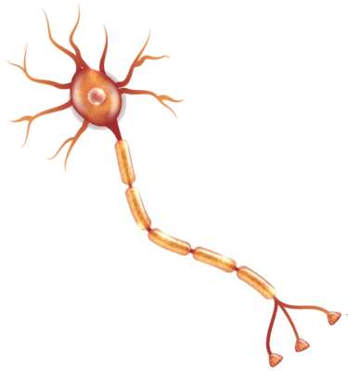
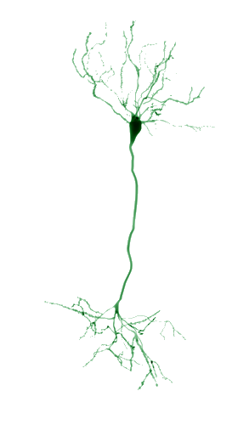
The main body of a nerve cell is somewhat star-shaped, with a long, thin fibre called an axon extending out from the cell.
The star-shaped body receives messages from other nerve cells, and then sends them down the axon to different nerve cells.

Slide 19

The axons of nerve cells can be very long, to allow them to transmit messages over long distances.
Their structure is ideally suited for their function. The longest axon in your body extends from the base of your spine down to your big toe, and can be over a metre long!

Slide 20
